Slide 1
CST 205 Object Oriented Programming Using Java
Prepared By,
Asst.Prof. Eldhose P Sim

Slide 2
Outcome Based Education (OBE)
The education that ensures that learners would achieve predefined outcomes for the programme in which they are enrolled.
Programme- Btech Artificial Intelligence & Data Science
Outcomes can be broadly classified as Program Outcomes (PO) and Course Outcomes (CO).
POs are statements that describe what students are expected to know and be able to do by the time of graduation.
COs are statements that describe what students are expected to know and be able to do upon course completion[Course-subject].

Slide 3
COURSE OUTCOMES
SNo | Course Outcomes | Related Module | Level
CO1 | Apply object-oriented analysis and design methods and Unified modelling Language notations to create effective and efficient system designs. | 1 | L3
CO2 | Develop Java application programs using java constructs, operators, control statements, built in packages, input /output streams, files and libraries and advanced features of java. | 1,2,3,4 | L3
CO3 | Apply object-oriented features to solve various computing problems using Java. | 2,3 | L3
CO4 | Illustrate how robust programs can be written in Java using exception handling Mechanism. | 3 | L2
CO5 | Develop application programs in Java using multithreading and database connectivity. | 4,5 | L3
CO6 | Develop GUI based application programs in java utilising event handling and Swing. | 4,5 | L3

Slide 4
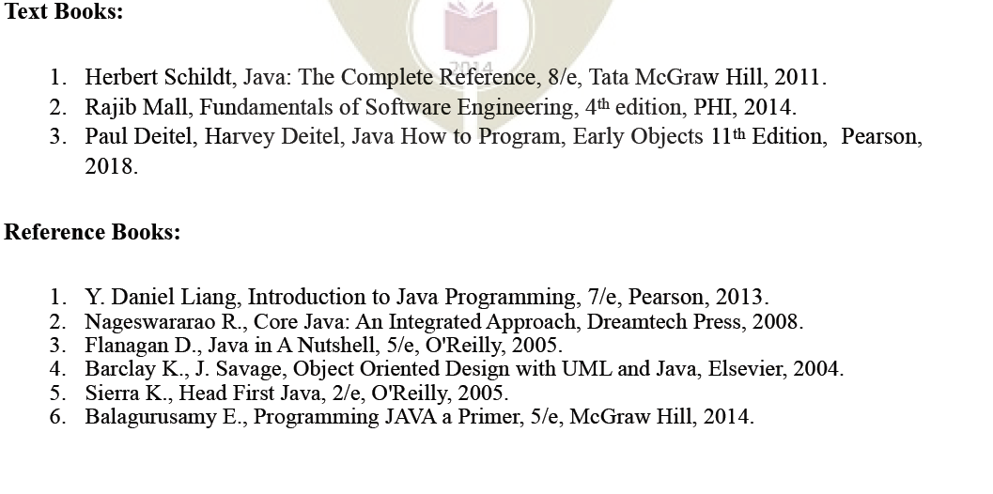
REFERENCE TEXTBOOKS FOR THE COURSE

Slide 5
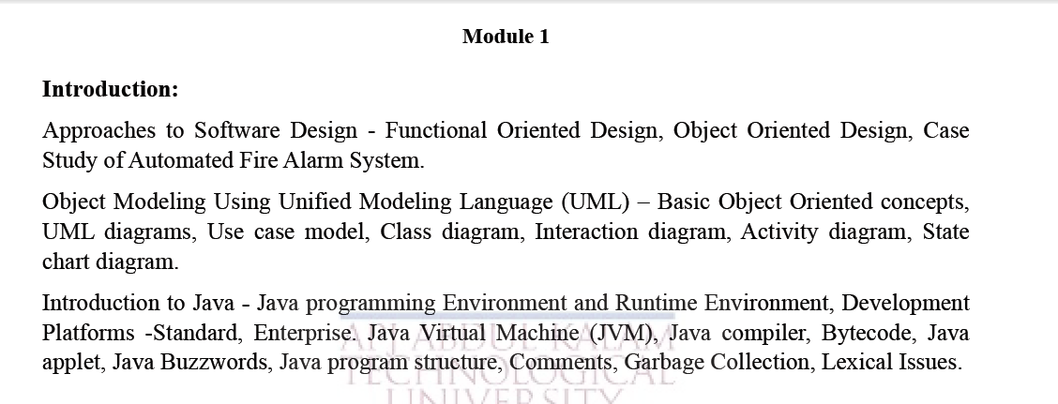
SYLLABUS OF MODULE 1

Slide 6
OBJECTIVES
To give an outline about software engineering.
To explain about software development lifecycle.
To illustrate software design approaches.

Slide 7

SOFTWARE ENGINEERING
Software engineering discusses systematic and cost-effective techniques for software development. These techniques help develop software using an engineering approach.
Software life cycle
The life cycle of a software represents the series of identifiable stages through which it evolves during its life time.
A Software development life cycle (SDLC) model (also called software life cycle model and software development process model) describes the different activities that need to be carried out for the software to evolve in its life cycle.

Slide 8

SOFTWARE ENGINEERING
Software : Software is a collection of instructions that enable the user to
interact with a computer , its hardware or perform tasks.
There are two types of software
1. System Software
2. Application Software
Examples of system software are Operating System,
Compilers, Interpreter, Assemblers, etc.
Examples of Application software are Railways
Reservation Software, Microsoft Office Suite Software,
Microsoft Word,Microsoft PowerPoint , etc.

Slide 9
Classical Waterfall Model
Classical waterfall model is intuitively the most obvious way to develop
software.
It is simple but idealistic.
In fact, it is hard to put this model into use in any non-trivial software development project.
All other life cycle models can be thought of as being extensions of the classical waterfall model.

Slide 10
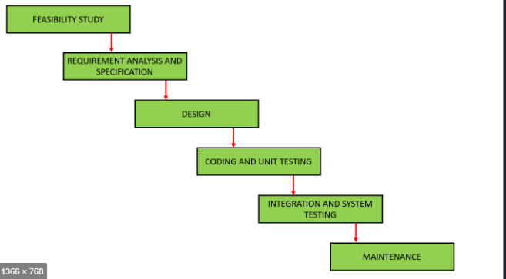
Classical Waterfall Model

Slide 11
Phases of the classical waterfall model
Feasibility study
The main focus of the feasibility study stage is to determine whether it
would be financially and technically feasible to develop the software.
Requirements analysis and specification
The aim of the requirements analysis and specification phase is to understand the exact requirements of the customer and to document them properly.
This phase consists of two distinct activities, namely requirements gathering and analysis, and requirements specification.

Slide 12
Phases of the classical waterfall model
Design
The goal of the design phase is to transform the requirements specified
in the SRS document into a structure that is suitable for implementation
in some programming language.
In technical terms, during the design phase the software architecture is derived from the SRS document.
Two distinctly different design approaches
Function-oriented design(Procedural design approach)
Object-oriented design approach

Slide 13
Phases of the classical waterfall model
Coding and unit testing
The purpose of the coding and unit testing phase is to translate a
software design into source code and to ensure that individually each
function is working correctly.
The coding phase is also sometimes called the implementation phase, since the design is implemented into a workable solution in this phase.
The end-product of this phase is a set of program modules that have been individually unit tested.
The main objective of unit testing is to determine the correct working of the individual modules.

Slide 14
Phases of the classical waterfall model
Integration and system testing
During the integration and system testing phase, the different modules are integrated in a planned manner.
Integration of various modules are normally carried out incrementally over a number of steps.
Finally, after all the modules have been successfully integrated and tested, the full working system is obtained.
System testing is carried out on this fully working system

Slide 15
Phases of the classical waterfall model
Maintenance
Maintenance is carried out to correct errors that were not discovered during the product development phase.
Maintenance is carried out to improve the performance of the system, or to enhance the functionalities of the system based on customer’s requests.

Slide 16
APPROACHES TO SOFTWARE DESIGN
Design
The goal of the design phase is to transform the requirements specified in the SRS document into a structure that is suitable for implementation in some programming language.
In technical terms, during the design phase the software architecture is derived from the SRS document.
Two distinctly different design approaches are popularly being used at present—the procedural and object-oriented design approaches
Procedural or Function-oriented Design
Object-oriented Design

Slide 17
APPROACHES TO SOFTWARE DESIGN
Procedural or Function-oriented Design
The traditional design approach is in use in many software development projects at the present time.
This traditional design technique is based on the data flow-oriented design approach.
It consists of two important activities; first structured analysis of the requirements specification is carried out where the detailed structure of the problem is examined.
This is followed by a structured design step where the results of structured analysis are transformed into the software design.

Slide 18
APPROACHES TO SOFTWARE DESIGN
Procedural or Function-oriented Design
During structured analysis, functional decomposition of the system is achieved.
That is, each function that the system needs to perform is analysed and hierarchically decomposed into more detailed functions.
On the other hand, during structured design, all functions identified during structured analysis are mapped to a module structure.
This module structure is also called the highlevel design or the software architecture for the given problem. This is represented using a structure chart.

Slide 19
APPROACHES TO SOFTWARE DESIGN
Procedural or Function-oriented Design
The high-level design stage is normally followed by a detailed design stage.
During the detailed design stage, the algorithms and data structures for the individual modules are designed.
The detailed design can directly be implemented as a working system using a conventional programming language.

Slide 20
Function-oriented Design
Salient features of the function-oriented design approach:
1. Top-down decomposition
A system, to start with, is viewed as a black box that provides certain services (also known as high-level functions) to the users of the system.
Application of divide and conquer principle. Through this each high-level function is independently decomposed into detailed functions.
Graphical representation of the analysis results using data flow diagrams.(DFD)[hierarchical graphical model of a system]
During structured design phase the results of the structured analysis (that is, the DFD model) is converted into a structure chart.

Slide 21
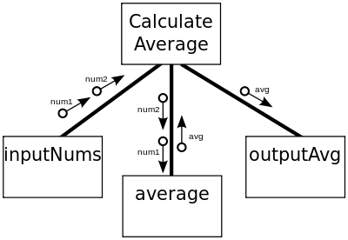
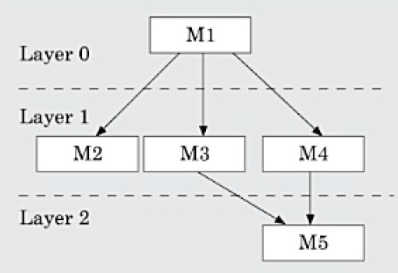
Function-oriented Design
Salient features of the function-oriented design approach:
Structure chart represents the software architecture.
The various modules making up the system, the module dependency (i.e. which module calls which other modules), and the parameters that are passed among the different modules.
The structure chart representation can be easily implemented using some programming language

Slide 22
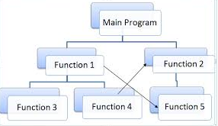
Function-oriented Design

Slide 23
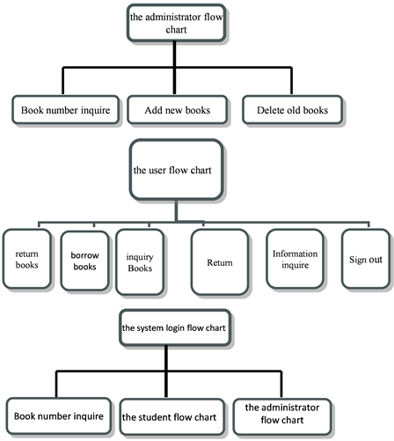
Function-oriented Design :Design of Library Management System

Slide 24
Function-oriented Design
Consider a function create-new-library member which essentially creates the record for a new member, assigns a unique membership number to him, and prints a bill towards his membership charge.
This high-level function may be refined into the following sub functions:
assign-membership-number
create-member-record
print-bill
Each of these sub functions may be split into more detailed sub functions and so on.

Slide 25
Function-oriented Design
2.Centralised system state
The system state can be defined as the values of certain data items that determine the response of the system to a user
action or external event.
For example, the set of books (i.e. whether borrowed by different users or available for issue) determines the state of a library automation system.
Such data in procedural programs usually have global scope and are shared by many modules.

Slide 26
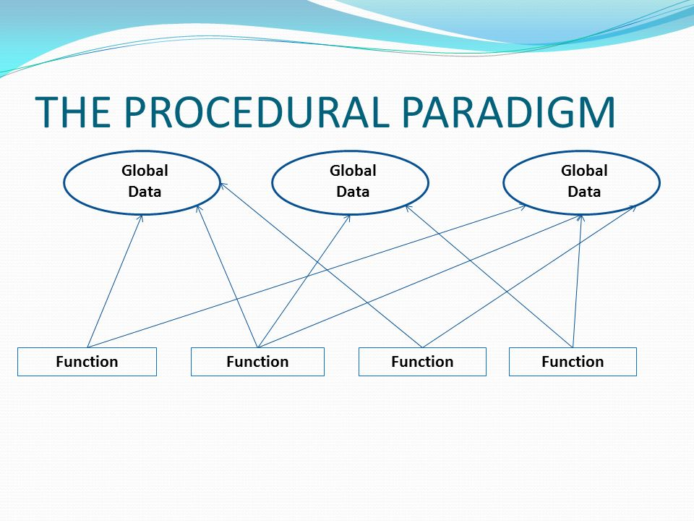
Function-oriented Design

Slide 27
Function-oriented Design
For example, in the library management system, several functions such as the following share data such as member-records for reference and updation:
create-new-member
delete-member
update-member-record

Slide 28
Object-oriented Design
In the object-oriented design (OOD) approach, a system is viewed as
being made up of a collection of objects (i.e. entities).
Each object is associated with a set of functions that are called its methods.
Each object contains its own data and is responsible for managing it.
The data internal to an object cannot be accessed directly by other objects and only through invocation of the methods of the object.
The system state is decentralised since there is no globally shared data in the system and data is stored in each object.
For example, in a library automation software, each library member may be a separate object with its own data and functions to operate on the stored data.

Slide 29
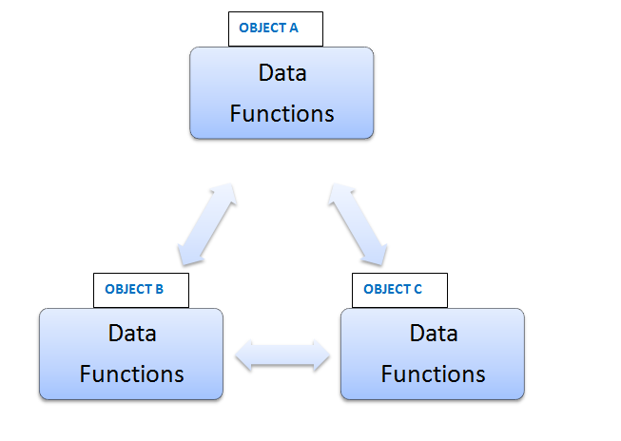
Object-oriented Design

Slide 30
Object-oriented Design
The object-oriented design paradigm makes extensive use of the principles of abstraction and decomposition as explained below.
Objects decompose a system into functionally independent modules. Objects can also be considered as instances of abstract data types (ADTs).
Three important concepts associated with abstract data types (ADTs)
Abstraction
Data structure
Data type

Slide 31
Object-oriented Design
Data abstraction
The principle of data abstraction implies that how data is exactly stored is abstracted away.
This means that any entity external to the object (that is, an instance of an ADT) would have no knowledge about how data is exactly stored, organised, and manipulated inside the object.
The entities external to the object can access the data internal to an object only by calling certain well-defined methods supported by the object.

Slide 32
Object-oriented Design
Data abstraction
The data of objects are encapsulated within the methods.
The encapsulation principle is also known as data hiding.
The encapsulation principle requires that data can be accessed and manipulated only through the methods supported by the object and not directly.
The principle of abstraction is used, it makes the design solution easily understandable and helps to manage complexity.

Slide 33
Object-oriented Design
Data structure:
A data structure is constructed from a collection of primitive data items.
Just as a civil engineer builds a large civil engineering structure using primitive building materials such as bricks, iron rods, and cement;
A programmer can construct a data structure as an organised collection of primitive data items such as integer, floating point numbers, characters, etc.

Slide 34
Object-oriented Design
Data type
A type is a programming language terminology that refers to anything that can be instantiated.
For example, int, float, char etc., are the basic data types supported by C programming language.
Class is a used defined datatype in java.[or Abstract Datatypes]

Slide 35
Object-oriented design VS Function oriented design
Unlike function-oriented design methods in OOD, the basic abstraction is not the services available to the users of the system such as issuebook ,display-book-details, find-issued-books, etc., But real-world entities such as member, book, book-register, etc.
For example in OOD, an employee pay-roll software is not developed by designing functions such as update-employee-record, get-employee-address,etc., but by designing objects such as employees, departments, etc.

Slide 36
Object-oriented design VS Function oriented design
In OOD, state information exists in the form of data distributed among several objects of the system.
In contrast, in a procedural design, the state information is available in a centralised shared data store.
For example, while developing an employee pay-roll system, the employee data such as the names of the employees, their code numbers, basic salaries, etc., are usually implemented as global data in a traditional programming system; whereas in an object-oriented design, these data are distributed among different employee objects of the system.
Objects communicate by message passing.

Slide 37
Object-oriented design VS Function oriented design
Assignment
Identify characteristics of FOD (Procedure oriented programming and OOP(Object oriented programming).
Differences between Procedural and Object Oriented Programming.
[Explain with an example –Banking process]

Slide 38
Automated fire-alarm system—customer requirements
The owner of a large multi-storied building wants to have a computerised fire alarm system designed, developed, and installed in his building.
Smoke detectors and fire alarms would be placed in each room of the building.
The fire alarm system would monitor the status of these smoke detectors.
Whenever a fire condition is reported by any of the smoke detectors, the fire alarm system should determine the location at which the fire has been sensed and then sound the alarms only in the neighbouring locations

Slide 39
Automated fire-alarm system—customer requirements
The fire alarm system should also flash an alarm message on the computer console.
Fire fighting personnel would man the console round the clock. After a fire condition has been successfully handled, the fire alarm system should support resetting the alarms by the fire fighting personnel.

Slide 40
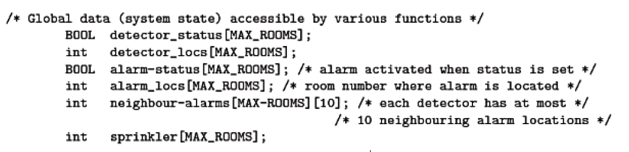
Function-oriented approach:
In this approach, the different high-level functions are first identified, and then the data structures are designed

Slide 41
Function-oriented approach:
The functions which operate on the system state are:
interrogate_detectors();
get_detector_location();
determine_neighbour_alarm();
determine_neighbour_sprinkler();
ring_alarm();
activate_sprinkler();
reset_alarm();
reset_sprinkler();
report_fire_location();

Slide 42
Object-oriented approach
In the object-oriented approach, the different classes of objects are identified.
Subsequently, the methods and data for each object are identified.
Finally, an appropriate number of instances of each class is created.

Slide 43
Object-oriented approach
class detector
attributes: status, location, neighbours
operations: create, sense-status, get-location,find-neighbours
class alarm
attributes: location, status
operations: create, ring-alarm, get_location, resetalarm
class sprinkler
attributes: location, status
operations: create, activate-sprinkler, get_location,reset- sprinkler

Slide 44
Object-oriented design VS Function oriented design
An object-oriented language facilitates the implementation of an OOD.
However, an OOD can as well be implemented using a conventional procedural languages—though it may require more effort to implement an OOD using a procedural language as compared to the effort required for implementing the same design using an object-oriented language.
Even though object-oriented and function-oriented techniques are remarkably different approaches to software design, yet one does not replace the other; but they complement each other in some sense.

Slide 45
SUMMARY
Two fundamentally different approaches to software design—function- oriented design and object-oriented design.
We discussed the essential philosophy governing these two approaches
and argued that these two approaches to software design are not really competing approaches but complementary approaches.

